Slide 1
Digital Portfolio
STUDENT NAME:D. SELVI
REGISTER NO AND NMID: 212401030/
F680EEB7936EB10B8354504FFB5B782A
DEPARTMENT: COMPUTER APPLICATIONS
COLLEGE:UNIVERSITY OF MADRAS

Slide 2
PROJECT TITLE
DIGITAL PORTFOLIO USING
FRONT END WEB DEVELOPMENT

Slide 3


AGENDA
Problem Statement
Project Overview
End Users
Tools and Technologies
Portfolio design and Layout
Features and Functionality
Results and Screenshots
Conclusion
Github Link
3/21/2024 Annual Review

Slide 4

PROBLEM STATEMENT
fresh graduates struggle to showcase their skills, projects, and qualifications in a professional and accessible way. To address this, a personal portfolio website is designed for SELVI D, a BCA graduate, highlighting her About Me, Skills, Projects, and Contact sections with a simple, responsive, and user-friendly interface.

Slide 5

PROJECT OVERVIEW
This project is a personal portfolio website developed for SELVI D, a BCA graduate, to showcase her professional profile in an interactive and organized manner. The website includes sections such as About Me, Skills, Projects, and Contact, designed with HTML, CSS, and JavaScript for a responsive and user-friendly experience. It highlights her technical expertise, academic background, and project work, serving as a digital resume to improve career opportunities and professional visibility.

Slide 6

WHO ARE THE END USERS?
Recruiters / Hiring Managers – People looking for potential candidates with skills in web development, programming, and database management.
Clients – Individuals or businesses who might want to hire Selvi D for freelance projects or collaborations.
Peers / Colleagues – Other developers or students who want to connect, collaborate, or share knowledge.
Mentors / Professors – Academic guides who may want to see Selvi’s skills and projects for feedback or recommendation purposes.
Networking Contacts – Professionals on LinkedIn, tech communities, or hackathons who may check the portfolio before engaging.
👉 In short, the main end users are employers, clients, and professional connections who want to quickly understand Selvi’s skills, background, and project work.

Slide 7

TOOLS AND TECHNIQUES
I used HTML, CSS, JavaScript, Python, and MySQL as core tools to build the portfolio. For development and testing, I worked on OneCompiler. Key techniques include responsive web design, clean UI/UX layout, structured navigation, and effective project showcasing to make the site user-friendly and professional.

Slide 8
POTFOLIO DESIGN AND LAYOUT
The portfolio is designed with a clean and responsive layout using HTML, CSS, and JavaScript. It includes structured sections like About Me, Skills, Projects, and Contact for easy navigation. The design focuses on user-friendly interface, readability, and simple color themes to present information clearly and professionally.
8

Slide 9
FEATURES AND FUNCTIONALITY
The portfolio includes About Me, Skills, Projects, and Contact sections for clear presentation. It is responsive, ensuring mobile and desktop compatibility. The layout provides easy navigation, structured content, and a simple UI/UX to showcase skills and projects effectively.

Slide 10
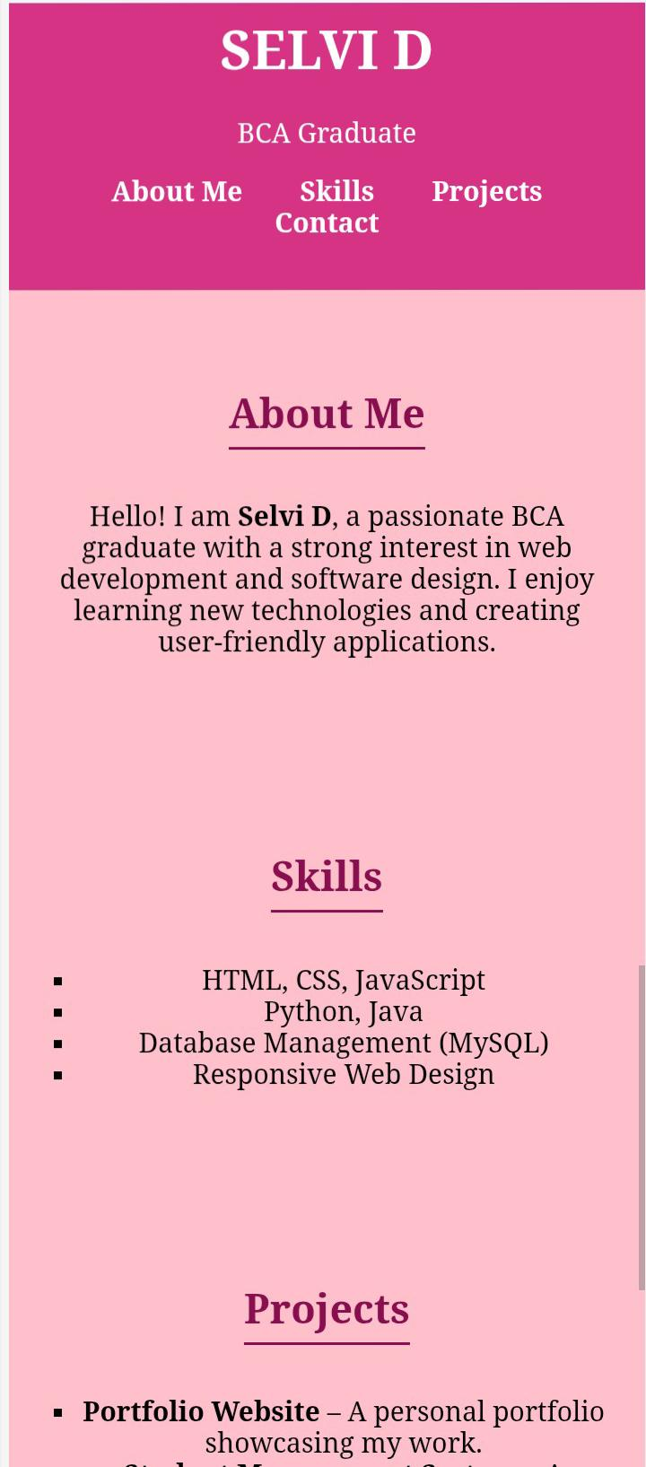

RESULTS AND SCREENSHOTS
3/21/2024 Annual Review
10

Slide 11
CONCLUSION
This portfolio reflects my skills, projects, and passion for web development and software design. I aim to keep learning new technologies and building user-friendly, responsive applications that solve real-world problems.
11

Slide 12
Github Link
https://github.com/Selvi-alt/Selvi-.git

